Slide 1
BOSH

Slide 2
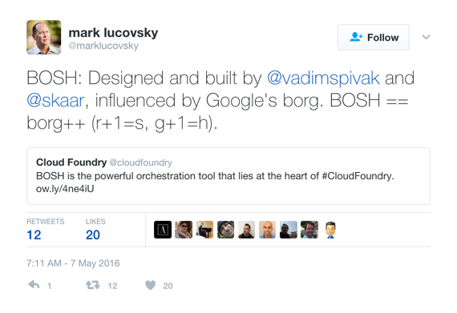
BOSH is an open source tool for release engineering, deployment, lifecycle management, and monitoring of distributed systems.
Notes:
BOSH was created in 2010 by VMWare
2013 Pivotal was spun out of VMWare taking BOSH with it
Pivotal donated the BOSH project the the Cloud Foundry Foundation
BOSH is a project of the Cloud Foundry Foundation
BOSH uses the Apache 2.0 License
Actively developed since 2010
244 Contributors
Major contributions from CF Foundation members Pivotal, IBM, SAP, VMWare, Microsoft, Google and others

Slide 3
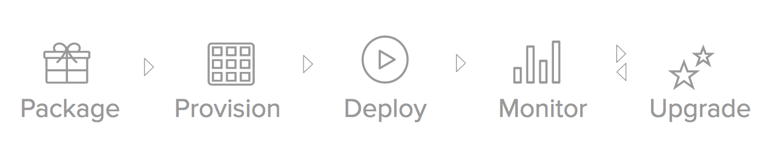

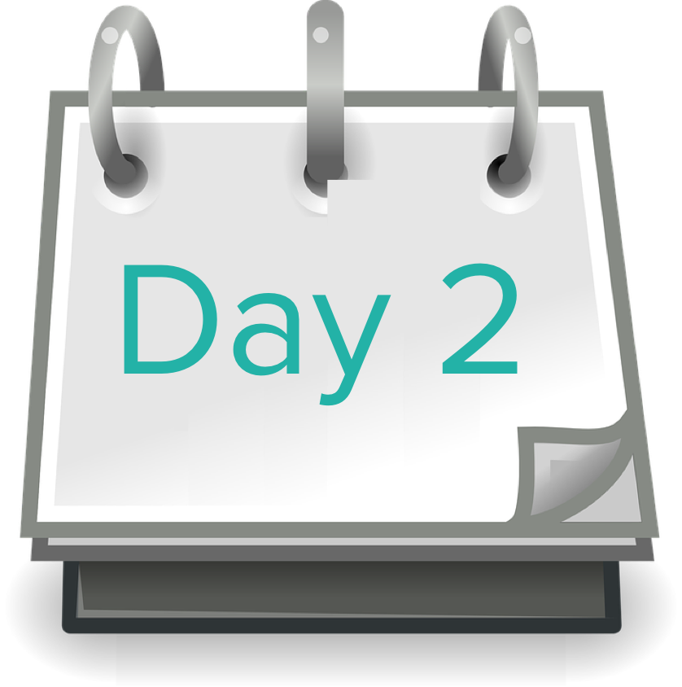
Packaging with embedded OS
Server provisioning on any IaaS
Software deployment across AZs
An open source tool chain for release engineering, deployment, and lifecycle management of large scale distributed services.
Health Monitoring (server & process)
Service & server state monitoring
Self-healing w/ Resurrector
Rolling upgrades with canaries
Dynamic scaling up or down
Repeatability and Consistency
Notes:
BOSH provides lifecycle management for large scale distributed systems that run on it. Unlike other configuration management and automation solutions, BOSH not only configures and deploys your services on Day 1 but it also stays by your side for Day 2 onwards to operate the service.
BOSH deployed the service on Day 1 so it already knows what state the service and the underlying infrastructure on which it depends should look like when they’re healthy, on Day 2 and beyond.
And BOSH helps with other Day 2 tasks such as upgrades to any part of the platform - service, operating system or even BOSH itself - with zero downtime using the canary pattern and automated rollbacks.
For Day 1, BOSH provisions infrastructure from the underlying IaaS such as Virtual Machines, Network and Storage. Using the CPI, BOSH can talk to a range of different IaaS providers such as public clouds like Azure, AWS and GCP but also on-premises IaaS including Vmware, Azure Stack and OpenStack. If you decide to change IaaS you don’t need to change your BOSH configuration thanks to the BOSH’s CPI abstraction.
BOSH enforces declarative and immutable infrastructure on top of IaaS providers.
Next, BOSH deploys your service across its clusters using one of the embedded operating system images that come with BOSH. Having embedded operating systems is great for security because you control them and keep them patched for maximum protection from vulnerabilities.
On Day 2, BOSH monitors both the services running on it and the underlying infrastructure on which those services depend. In the event of a failure of either, BOSH will intelligently restart processes and servers in order to restore the service to it’s defined ‘good’ state.
Updates to the service, embedded OS images, BOSH or other components happen with zero downtime, thanks to BOSH’s use of the canary pattern and automated rollback in case of a bad update.
Using BOSH, services can be dynamically scaled up or down to cope with changing demands though a simple edit to the service’s BOSH manifest or API call.

Slide 4





BOSH Architecture
BOSH
Cloud Provider Interface
CLI
IaaS API
Registry
Health Monitor
BOSH provides the means to go from deployment configuration to VM creation and management. It includes interfaces for Azure, vSphere, AWS, GCP, and OpenStack. Additional CPI can be written for alternative IaaS providers.
Director
NATS
Agent
Agent
Postgres
DB
Blob
Store
Agent
Agent
Notes:
Command Line Interface (CLI)
The Command Line Interface (CLI) is the primary operator interface to BOSH. An operator uses the CLI to interact with the Director and perform actions on the cloud.
CLI is typically installed on a machine that can directly communicate with the Director’s API, e.g. an operator’s laptop, or a jumpbox in the datacenter.
Director
The Director is the core orchestrating component in BOSH. The Director controls VM creation and deployment, as well as other software and service lifecycle events.
Cloud Provider Interface (CPI)
A Cloud Provider Interface (CPI) is an API that the Director uses to interact with an IaaS to create and manage stemcells, VMs, and disks. A CPI abstracts infrastructure differences from the rest of BOSH.
Health Monitor
The Health Monitor uses status and lifecycle events received from Agents to monitor the health of VMs. If the Health Monitor detects a problem with a VM, it can send an alert through notification plugins, or trigger the Resurrector.
Postgres Database
The Director uses a Postgres database to store information about the desired state of a deployment. This includes information about stemcells, releases, and deployments.
Blobstore
The Blobstore stores the source forms of releases and the compiled images of releases. An operator uploads a release using the CLI, and the Director inserts the release into the Blobstore. When you deploy a release, BOSH orchestrates the compilation of packages and stores the result in the Blobstore.
Agent
BOSH includes an Agent on every VM that it deploys. The Agent listens for instructions from the Director and carries out those instructions. The Agent receives job specifications from the Director and uses them to assign a role, or Job, to the VM.
For example, to assign the job of running MySQL to a VM, the Director sends instructions to the Agent on the VM. These instructions include which packages to install and how to configure those packages. The Agent uses these instructions to install and configure MySQL on the VM.
Message Bus (NATS)
The Director and the Agents communicate through a lightweight publish-subscribe messaging system called NATS. These messages have two purposes: to perform provisioning instructions on the VMs, and to inform the Health Monitor about changes in the health of monitored processes.
Registry
When the Director creates or updates a VM, it stores configuration information for the VM in the Registry so that it can be used during bootstrapping stage of the VM.

Slide 5
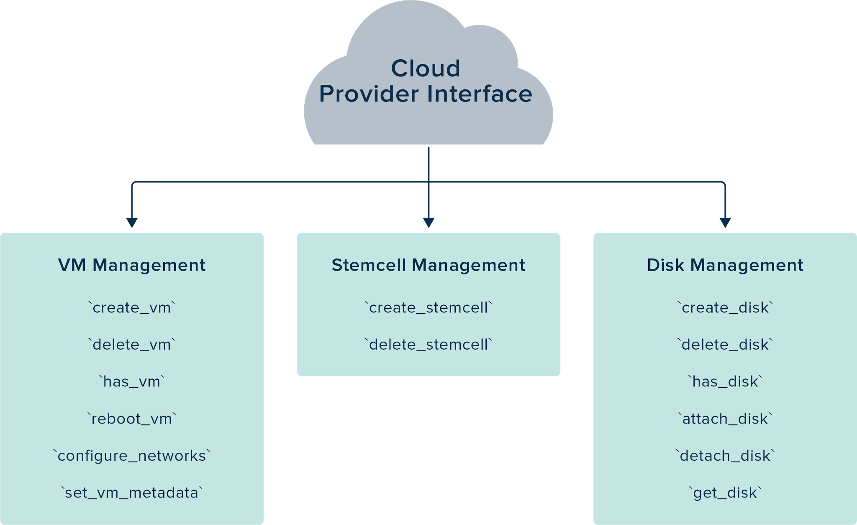
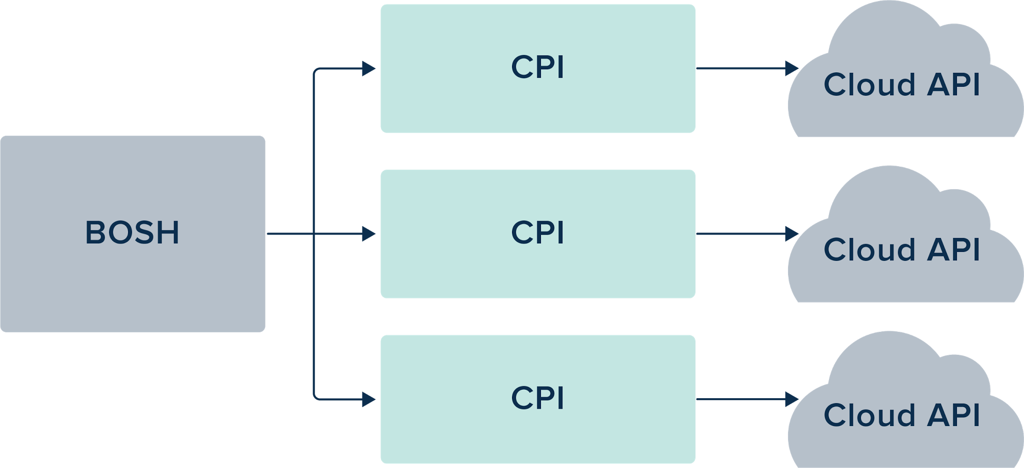
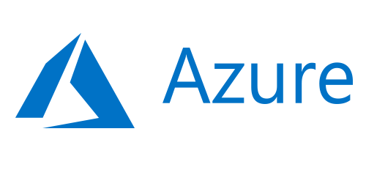

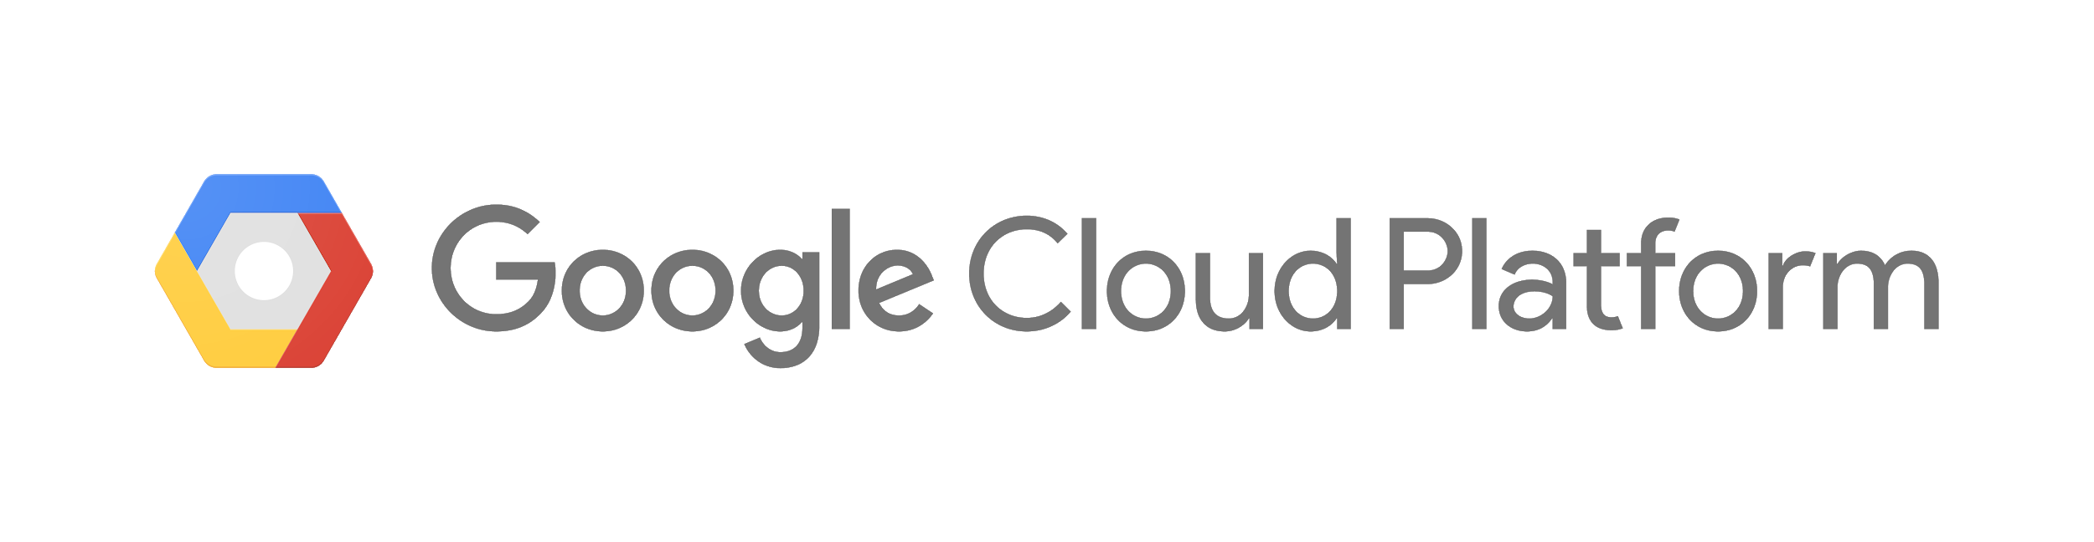
Multi-Cloud with BOSH + CPI
Notes:
The combination of BOSH and the Cloud Provider Interface (CPI) is what enabled multi- and hybrid- cloud. It simply takes the necessary commands to manipulate compute, network, and storage, packages it up by provider, and makes it available to BOSH, which can monitor and manage VM creation. Together, they allow for the same platform and the same apps to run in different clouds, either on premise or in the public cloud. By using a simple CPI against each supported IAAS, we can offer the highest level of flexibility when it comes to cloud vendor selection. Also think of this like an insurance policy against major outages by a cloud provider, as well as against cost increases incurred due to vendor lock-in.

Slide 6
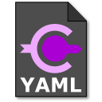
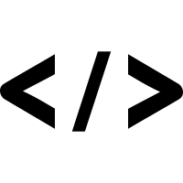

BOSH Deployments
w
Deployment
Manifest
Release
Stemcell

Slide 7
BOSH - Service Deployment
BOSH
Cloud Provider Interface
CLI
IaaS API
Stemcell
Registry
Manifest
Config
Health Monitor
Release
Director
NATS
Agent
Agent
Postgres
DB
Blob
Store
Agent
*
Agent
*

